Slide 1

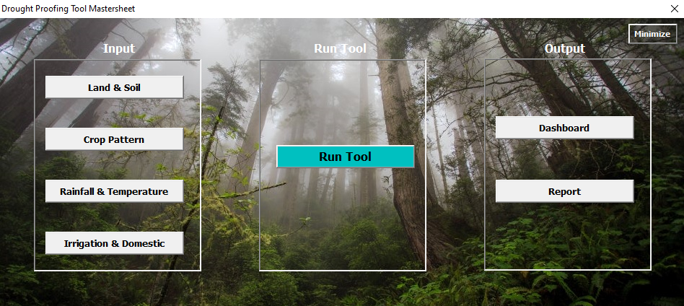
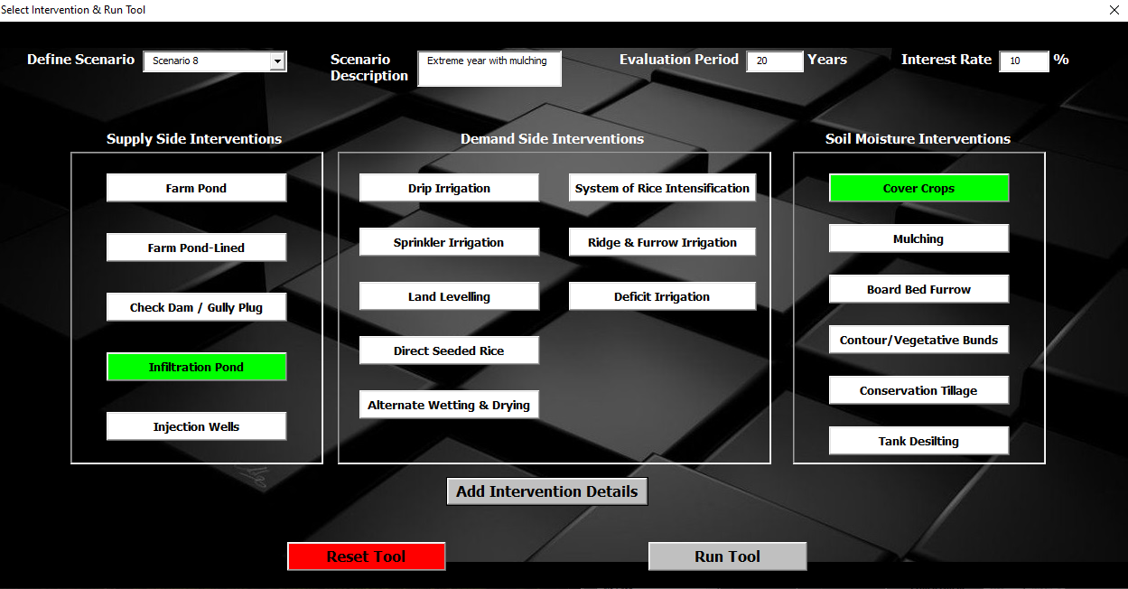
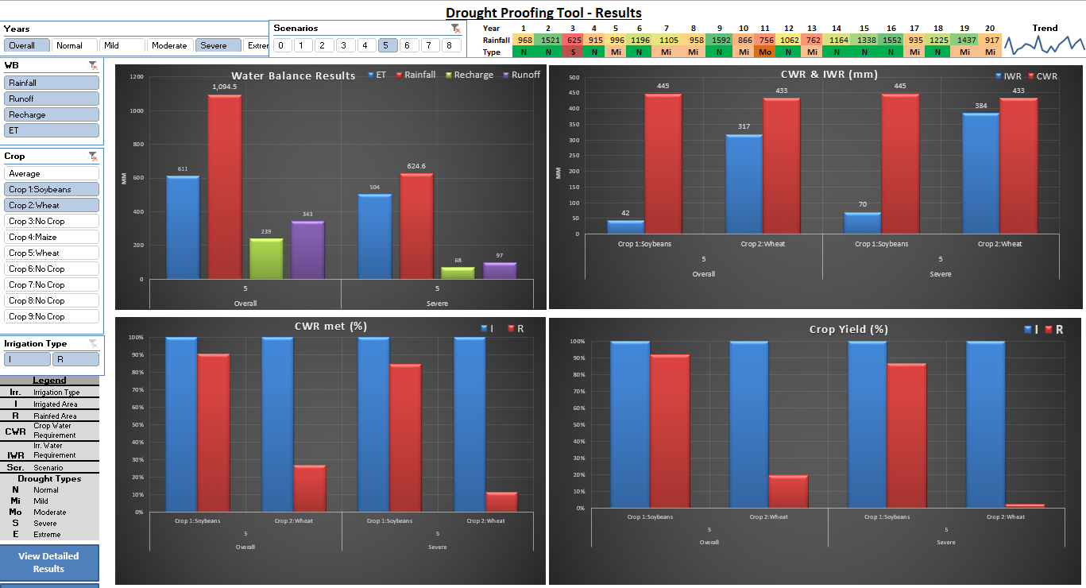
IWMI – ITC Knowledge Partnership
Drought Tool
Drought Proofing Tool
Tool helps in assessing the impact of drought on crops, design interventions and simulate the impacts
The too is applicable for small (10-100 km2) homogenous agri-catchments
Excel based, simple but conceptually robust.
Tool gives an idea what interventions to plan and what are the potential benefits, and in-turn prepare DPR (Helpful for field level NGO partners).
Capacity building: 2 day Annual workshop and 16 one to one sessions with state teams.
Tool is used by Karnataka Watershed department for actively planning interventions in 100 watersheds in 1.16 million acres of land in 29 districts in Karnataka.
Simulate Scenarios
Output

Slide 2
IWMI – ITC Knowledge Partnership
Water Security Framework
The framework assesses and captures the dynamic nature of water security with measurable indicators on a scale of 0 to 1.
Assessment of water security comprises of assessing water scarcities (supply & demand gap) and risks (probability) of meeting demand.
Delineate factory catchment area and identify co-dependants of the water source in the catchment
Assess current & future requirements for all changing climate and socio-economic environments
Water Quality is assessed as separate parameter (Water Quality Index)
Suggest interventions to improve water security
Capacity Building: Annual workshop and 5 one to one sessions with state teams
Water Security Framework
 |  |  |  | Very Severe
 |  |  | Severe
 |  | Moderate
 | Low
No
0.9
0.6
Risks
0.4
0.25
0
0.25
0.4
0.6
0.9
Scarcity

Slide 3
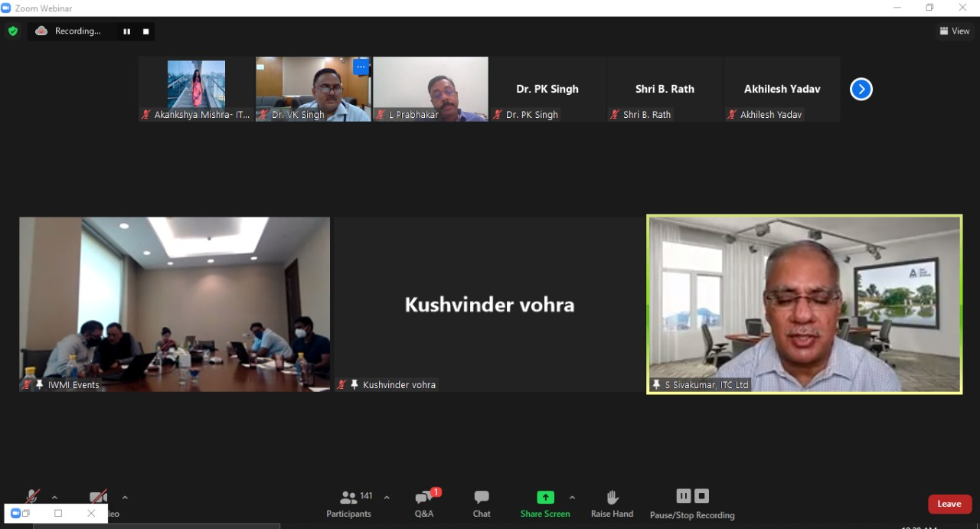
IWMI – ITC Workshop
National level virtual workshop on “Drought Proofing Agriculture and Water Security in Catchments” was organized to present the drought proofing framework + tool and water security framework to practitioners, policy makers and professionals
The Workshop was attended by ~150 participants/experts from Central Water Commission, Central Groundwater Board, National Rainfed Area Authority and Indian Council of Agricultural Research, NITI Aayog, NGOs, donors, private sector, research institutes.
Experts/Participants showed keen interest on using the tool and framework.
Policy recommendation was developed based on the discussions and feedbacks from experts.

